Slide 1


2019
Netcoreconf
Securing .Net Core APIs and WebApps with Azure Active Directory
Luis Mañez
Cloud Architect – ClearPeople LTD
@luismanez
26/01/2018

Slide 2

Securing .Net Core APIs and WebApps with Azure Active Directory

Slide 3
Sponsors

Slide 4


The Protocols
oAuth2
Provides Authorization framework
OpenIdConnect
Built on top of oAuth 2
Provides Authentication capabilities
/UserInfo endpoint
IdToken
Discovery service
/Authorize endpoint
Access Token
/Token endpoint
Refresh Token

Slide 5










The Players
Client (AKA App)
Public: native, mobile, user agent
Confidential: server
Authorization Server
Resource Owner
(AKA User)
Resource Server

Slide 6
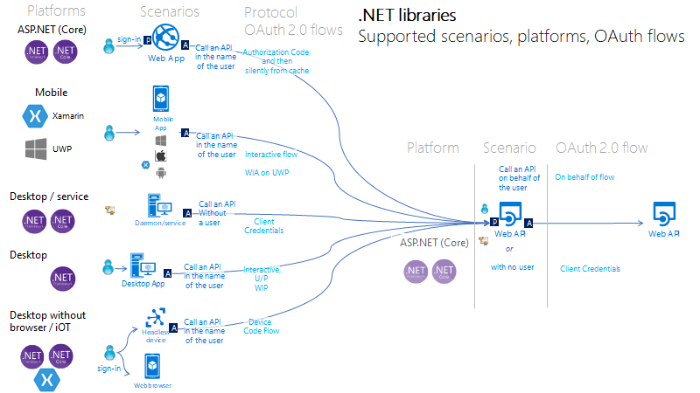
https://github.com/AzureAD/microsoft-authentication-library-for-dotnet/wiki/scenarios

Slide 7
https://joonasw.net/view/azure-ad-v2-and-msal-from-dev-pov
https://github.com/AzureAD/microsoft-authentication-library-for-dotnet/wiki/Adal-to-Msal
https://docs.microsoft.com/en-us/azure/active-directory/develop/sample-v2-code
https://github.com/AzureAD/microsoft-authentication-library-for-dotnet/wiki/scenarios
Manifest API: "accessTokenAcceptedVersion": 2

Slide 8
Más información:
info@netcoreconf.com
@Netcoreconf
Visítanos en:
2019.Netcoreconf.com
GRACIAS

Slide 9
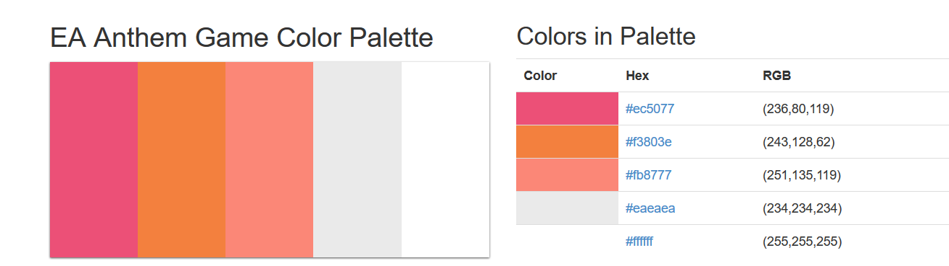

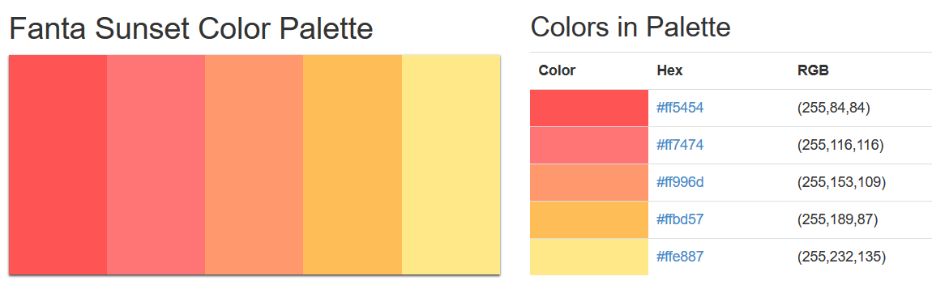
sambori
sam
bori
1
sambori
sambori
sambori
sambori
sambori
sambori
s
a
r
i
sambori
sambori
m
b
o
sambori
sambori
sambori
sambori
sambori
sambori

